Slide 1
Using Azure Functions in serverless applications
David Gristwood
Technical Evangelist
David.Gristwood@microsoft.com

Slide 2




Azure
Functions
Azure Functions
Code
Azure Functions
Events + data
Process events with Serverless code.
BAM!!!
Make composing Cloud Apps insanely easy
Develop Functions in C#, Node.js, F#, Python, PHP, Batch and more
Easily schedule event-driven tasks across services
Expose Functions as HTTP API endpoints
Scale Functions based on customer demand
Easily integrate with Logic Apps

Slide 3
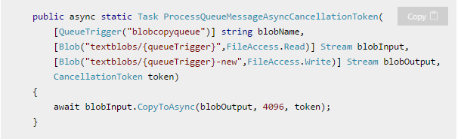
What is the “Functions” programming model?
Function as the unit of work
Functions are executed; they start and finish
Functions have inputs and outputs
a.k.a. “Nano Services”

Slide 4
What is the “Functions” architecture ?
Helps decouples business logic
Easier to upgrade, scale, balance load, etc
Mean no “server estate” to manage
Drives an event driven model
Supports models such as CQRS

Slide 5
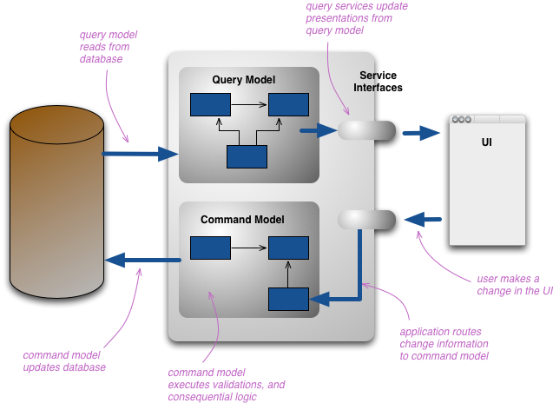
Command Query Responsibility Segregation (CQRS)
Alternative to traditional CRUD data access
Split into separate models for update and display
A command is any method that mutates state
A query is any method that returns a value
Adds complexity, so use for more complex system, such as high performance, geo-distributed, etc

Slide 6
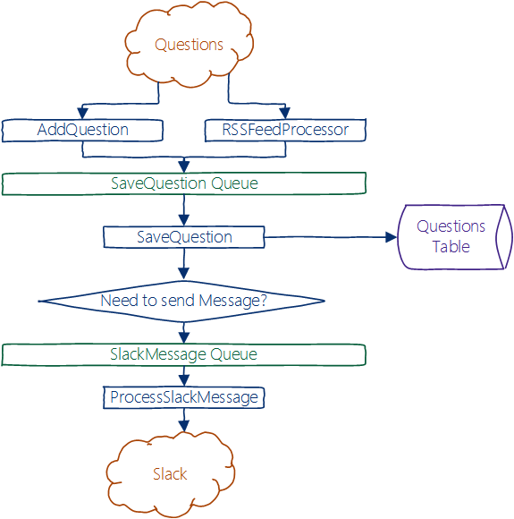
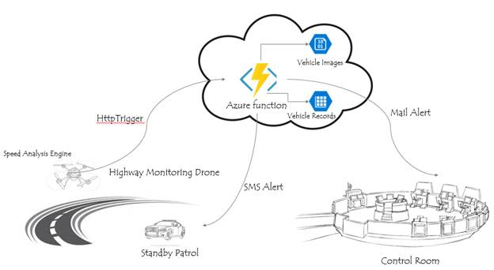
Event Drive Model

Slide 7
Best practices for the “Functions” programming model
Functions should “do one thing”
Functions should be idempotent
Functions should finish as quickly as possible
1

Slide 8
The “Functions” programming model
What is you need to do? (business logic wise)
Am I solving more than one business problem? Split up, go back to 1.
What will trigger the function?
Is there additional data I need?
Is there output I should produce?
“When ___, get ___, do ___, and output ___”

Slide 9
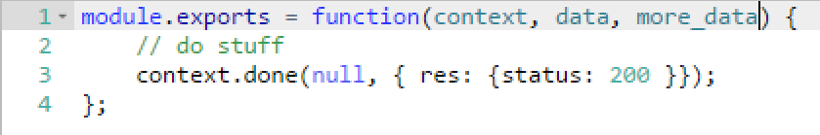
Functions programming concepts
Trigger
Input
Code
Output

Slide 10
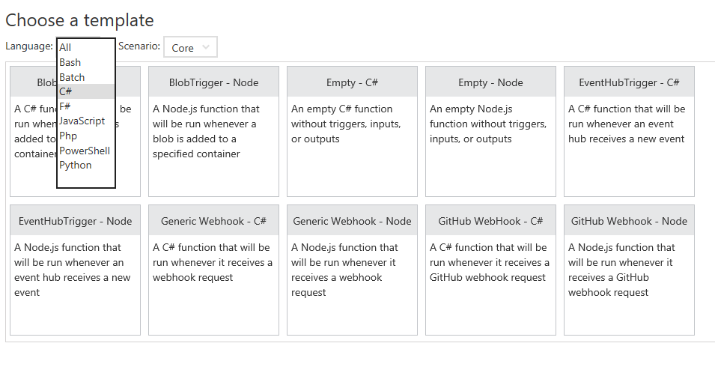
Azure Portal

Slide 11
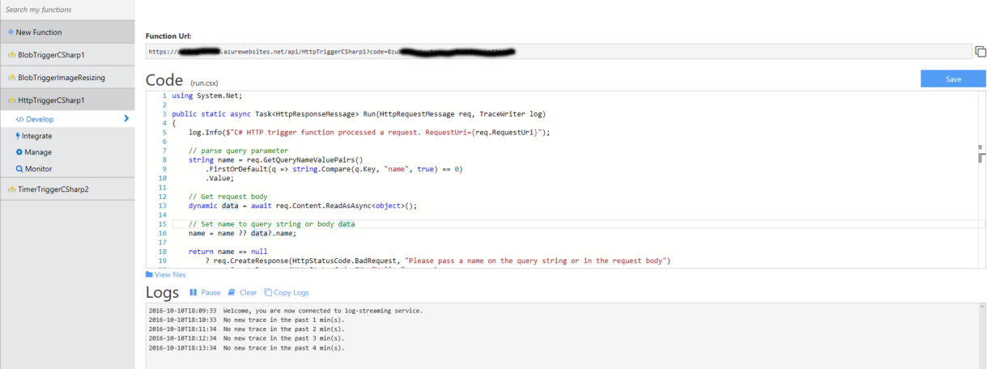
Develop

Slide 12
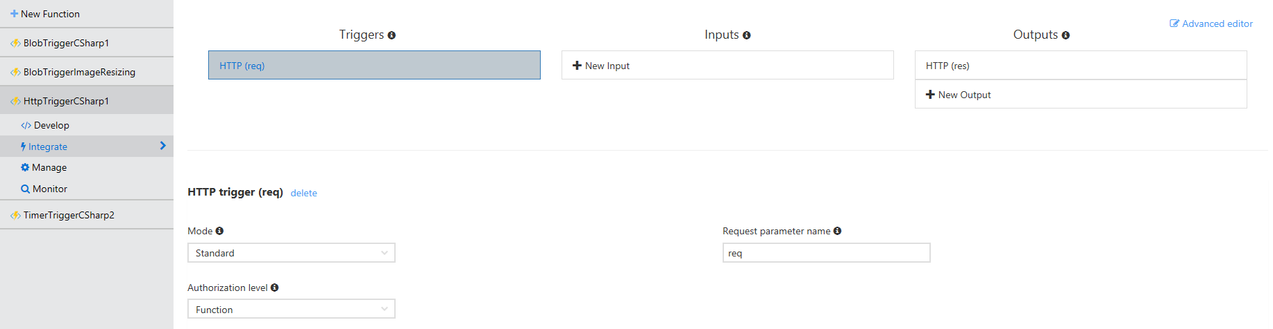
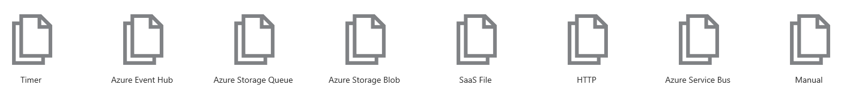
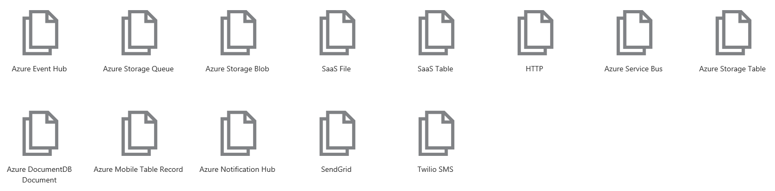
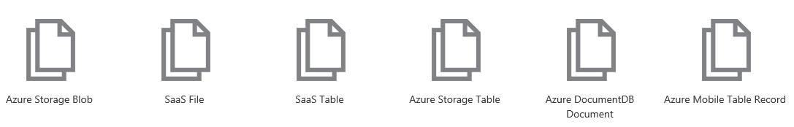
Integrate

Slide 13
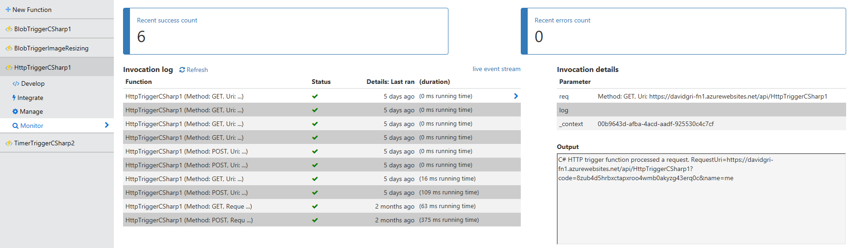
Monitor

Slide 14
Azure Functions architecture
Built on top of App Service and WebJobs SDK
Code
Config
Language Runtime C#, Node.js, F#, PHP, etc.
Azure Functions
WebJobs Script Runtime Azure Functions Host – Dynamic Compilation, Language abstractions, etc.
WebJobs Core
Programming model, common abstractions
WebJobs Extensions
Triggers, input and output bindings
App Service Dynamic Runtime Hosting, CI, Deployment Slots, Remote Debugging, etc.

Slide 15
Dual abstraction
Serverless compute abstracts away the compute
Bindings abstract away the services you interact with
Other Services
Business Logic
Serverless PaaS

Slide 16
Platform and scaling
App Service offers dedicated and dynamic tiers.
Dedicated is the existing App Service plan tiers
Basic, Standard, Premium
Pay based on # of reserved VMs
You’re responsible for scale
Dynamic
Pay on number of executions
Platform responsible for scale

Slide 17
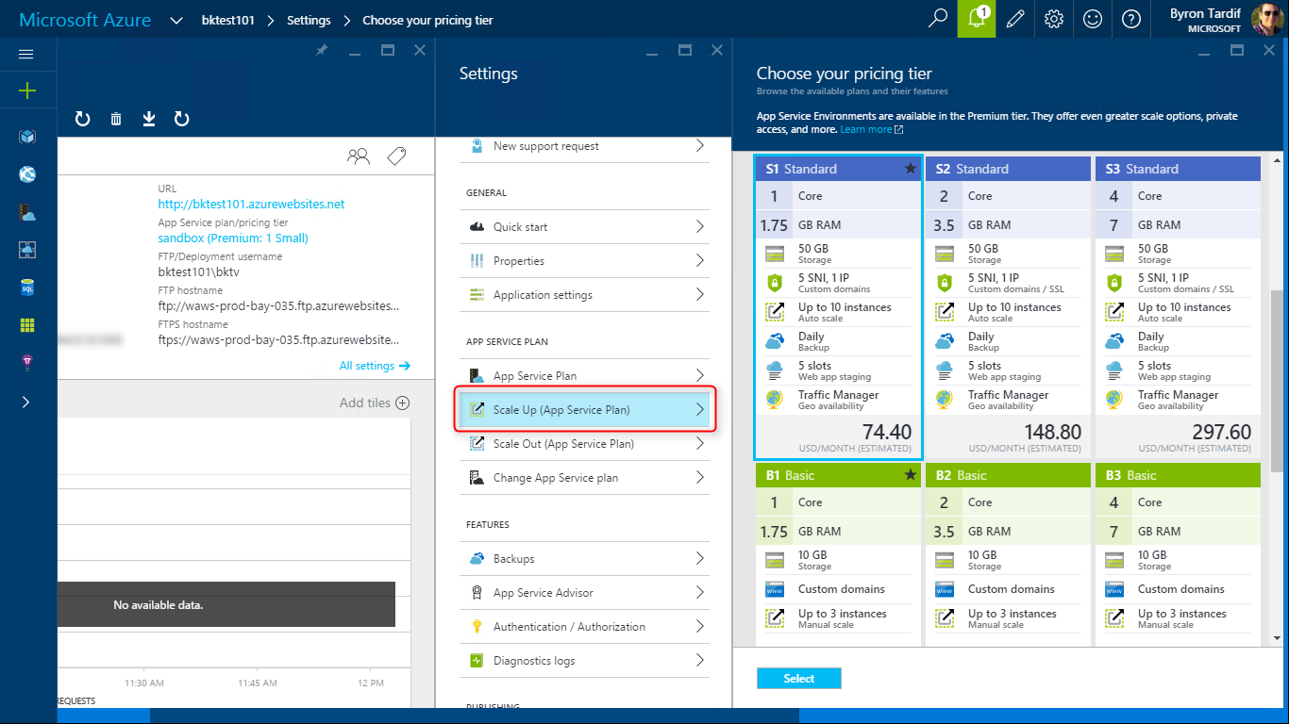
App Service Plans

Slide 18
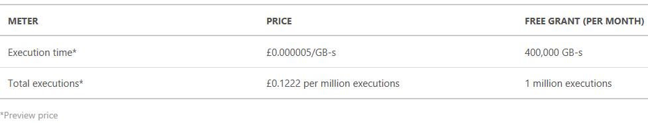
Dynamic tier pricing
Pay per execution:
Execution time
Metered in Gigabyte Seconds(GB-s)
Duration of execution (rounded to the nearest 100 ms) x reserved memory (128 MB increments between 128 MB and 1,536 MB)
Free grant of 400,000 GB-s execution time per month
Number of executions
The first million executions included free each month
https://azure.microsoft.com/en-gb/pricing/details/functions/

Slide 19
WebJobs SDK vs Azure Functions
Philosophy:
WebJobs SDK == more freedom -> more work
Azure Functions == less responsibilities -> less work

Slide 20
Commonalities
Both use the ”Function” oriented programming model
Both support ”bindings” for trigger/input/output
Both support WebJobs SDK extensions model
Both support external libraries being used
Both can run locally and be debugged
Both have runtime telemetry via the WebJobs Dashboard

Slide 21
Hosting model differences
WebJobs SDK
You configure host
Build a console app which is run
Azure Functions
Limited control over the host
Just give it your code/config
WebJobs & Dedicated App Service plans
Runs the service in the background of Web/Mobile/API app
Runs any console app (not just SDK based ones)
You manage scale
Function App + Dynamic App Service Plans
Function app owns the whole host, including web frontend.
Only runs Azure Functions stuff – no other things
Scale is managed for you

Slide 22
Hosting model differences
WebJobs SDK
You configure host
Build a console app which is run
Azure Functions
Limited control over the host
Just give it your code/config
WebJobs & Dedicated App Service plans
Runs the service in the background of Web/Mobile/API app
Runs any console app (not just SDK based ones)
You manage scale
Function App + Dynamic App Service Plans
Function app owns the whole host, including web frontend.
Only runs Azure Functions stuff – no other things
Scale is managed for you

Slide 23

Portal
https://functions.azure.com/
Azure.com
https://azure.microsoft.com/documentation/services/functions
GitHub
https://github.com/Azure/Azure-Functions
Image resizing sample
https://blogs.msdn.microsoft.com/martinkearn/2016/05/06/smart-image-re-sizing-with-azure-functions-and-cognitive-services/

